Slide 1

PIZZA DAY
APRIL
SALFORD & CO.
2026
SQL Project

Slide 2


APRIL
SALFORD & CO.
2026
WHAT IS PIZZA DAY?
PIZZA DAY IS YOUR NEIGHBORHOOD DESTINATION FOR DELICIOUS, VERSATILE PIZZAS LOVED BY MILLIONS. MORE THAN JUST A MEAL, IT’S A CELEBRATION OF FLAVOR EVERY DAY.
AT PIZZA DAY, EVERY VISIT IS A CHANCE TO EXPLORE THE HISTORY, CULTURE, AND CREATIVITY BEHIND PIZZA—WHILE SAVORING ENDLESS FLAVORS CRAFTED JUST FOR YOU.

Slide 3



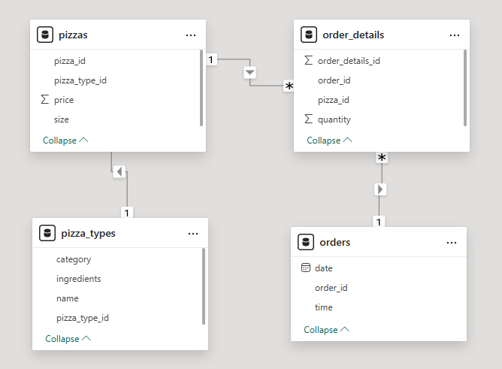
APRIL
SALFORD & CO.
2026
THE DATA MODEL OF PIZZA DAYS DATA

Slide 4

APRIL
SALFORD & CO.
2026
LIST OF BUISNESS PROBLEMS
QUESTIONS
1) Retrieve the total number of orders placed.
2) Calculate the total revenue generated from pizza sales.
3) Identify the highest-priced pizza.
4) Identify the most common pizza size ordered.
5)List the top 5 most ordered pizza types along with their quantities.
6) Join the necessary tables to find the total quantity of each pizza category ordered.
7) Determine the distribution of orders by hour of the day.
8) Join relevant tables to find the category-wise distribution of pizzas.
9) Group the orders by date and calculate the average number of pizzas ordered per day.
10 )Analyze the cumulative revenue generated over time.
TODAY, PIZZA IS A UNIVERSAL LANGUAGE OF COMFORT AND INDULGENCE.

Slide 5


APRIL
SALFORD & CO.
2026
1) RETRIEVE THE TOTAL NUMBER OF ORDERS PLACED.
QUERY
OUTPUT

Slide 6

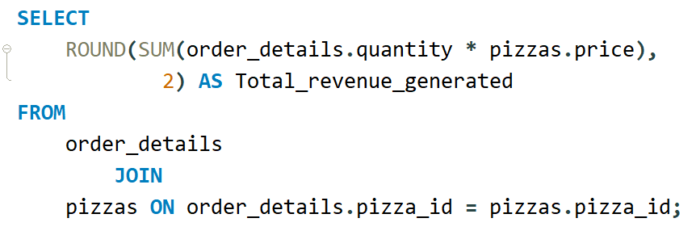

APRIL
SALFORD & CO.
2026
2) CALCULATE THE TOTAL REVENUE GENERATED FROM PIZZA SALES
QUERY
OUTPUT

Slide 7
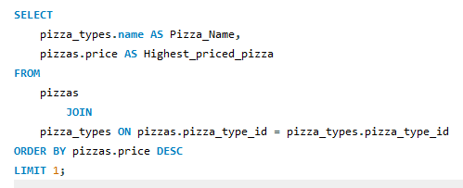

APRIL
SALFORD & CO.
2026
3) IDENTIFY THE HIGHEST-PRICED PIZZA
QUERY
OUTPUT

Slide 8
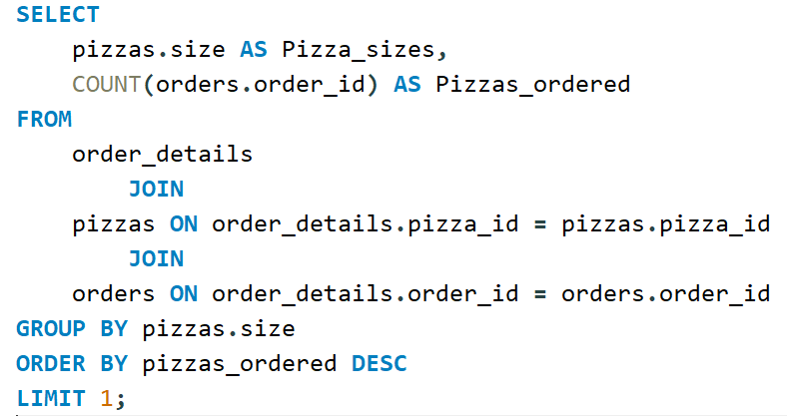

APRIL
SALFORD & CO.
2026
4) IDENTIFY THE MOST COMMON PIZZA SIZE ORDERED.
QUERY
More than food—it’s a cultural phenomenon.
OUTPUT

Slide 9
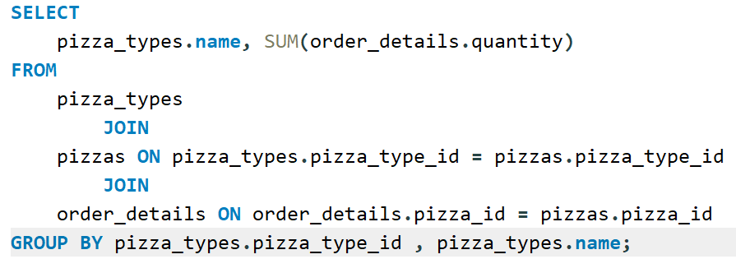

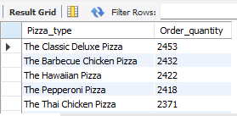
APRIL
SALFORD & CO.
2026
5) LIST THE TOP 5 MOST ORDERED PIZZA TYPES ALONG WITH THEIR QUANTITIES.
QUERY
OUTPUT

Slide 10

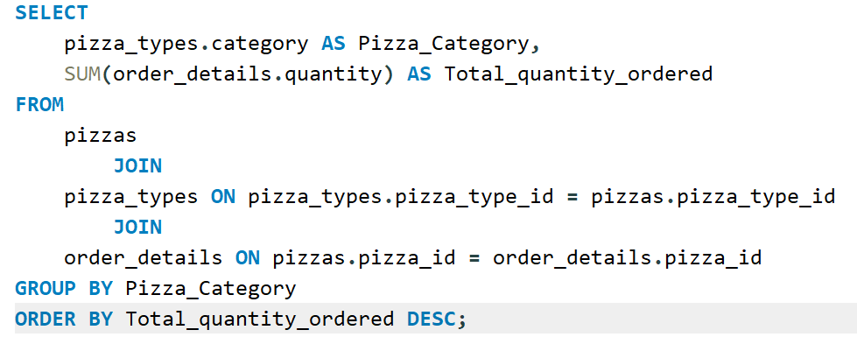
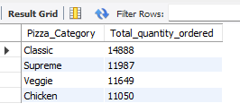
APRIL
SALFORD & CO.
2026
6) JOIN THE NECESSARY TABLES TO FIND THE TOTAL QUANTITY OF EACH PIZZA CATEGORY ORDERED.
QUERY
Where the fun is as endless as the toppings.
OUTPUT

Slide 11
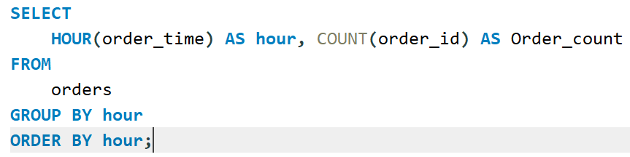
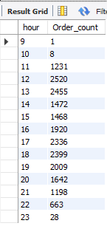

APRIL
SALFORD & CO.
2026
7) DETERMINE THE DISTRIBUTION OF ORDERS BY HOUR OF THE DAY.
QUERY
OUTPUT

Slide 12
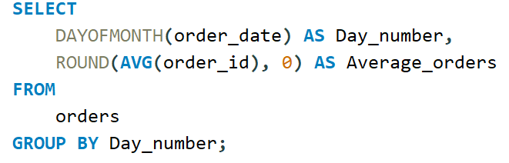
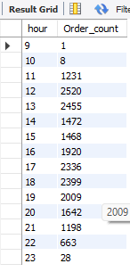
APRIL
SALFORD & CO.
2026
9) GROUP THE ORDERS BY DATE AND CALCULATE THE AVERAGE NUMBER OF PIZZAS ORDERED PER DAY.
QUERY
OUTPUT
Crafting the perfect pie, right in your kitchen.

Slide 13
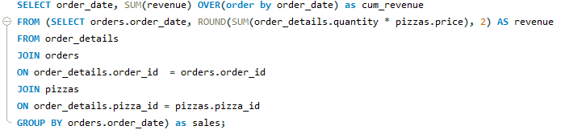
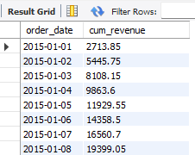
APRIL
SALFORD & CO.
2026
10)CALCULATE THE PERCENTAGE CONTRIBUTION OF EACH PIZZA TYPE TO TOTAL REVENUE.
QUERY
OUTPUT

Slide 14
APRIL
SALFORD & CO.
2026
THANK YOU
123 ANYWHERE ST., ANY CITY, ST 12345

